Slide 1
Normal Brain
Images: Brain cross sections:
Horizontal through the top of the skull:
http://www-medlib.med.utah.edu/WebPath/HISTHTML/ANATOMY/VHM1080R.html
Horizontal through the midbrain:
http://www-medlib.med.utah.edu/WebPath/HISTHTML/ANATOMY/VHM1120R.html
Information on brain anatomy and physiology:
Gray’s Anatomy – Brain:
http://www.bartleby.com/107/189.html
How Stuff Works:
http://health.howstuffworks.com/brain.htm

Slide 2
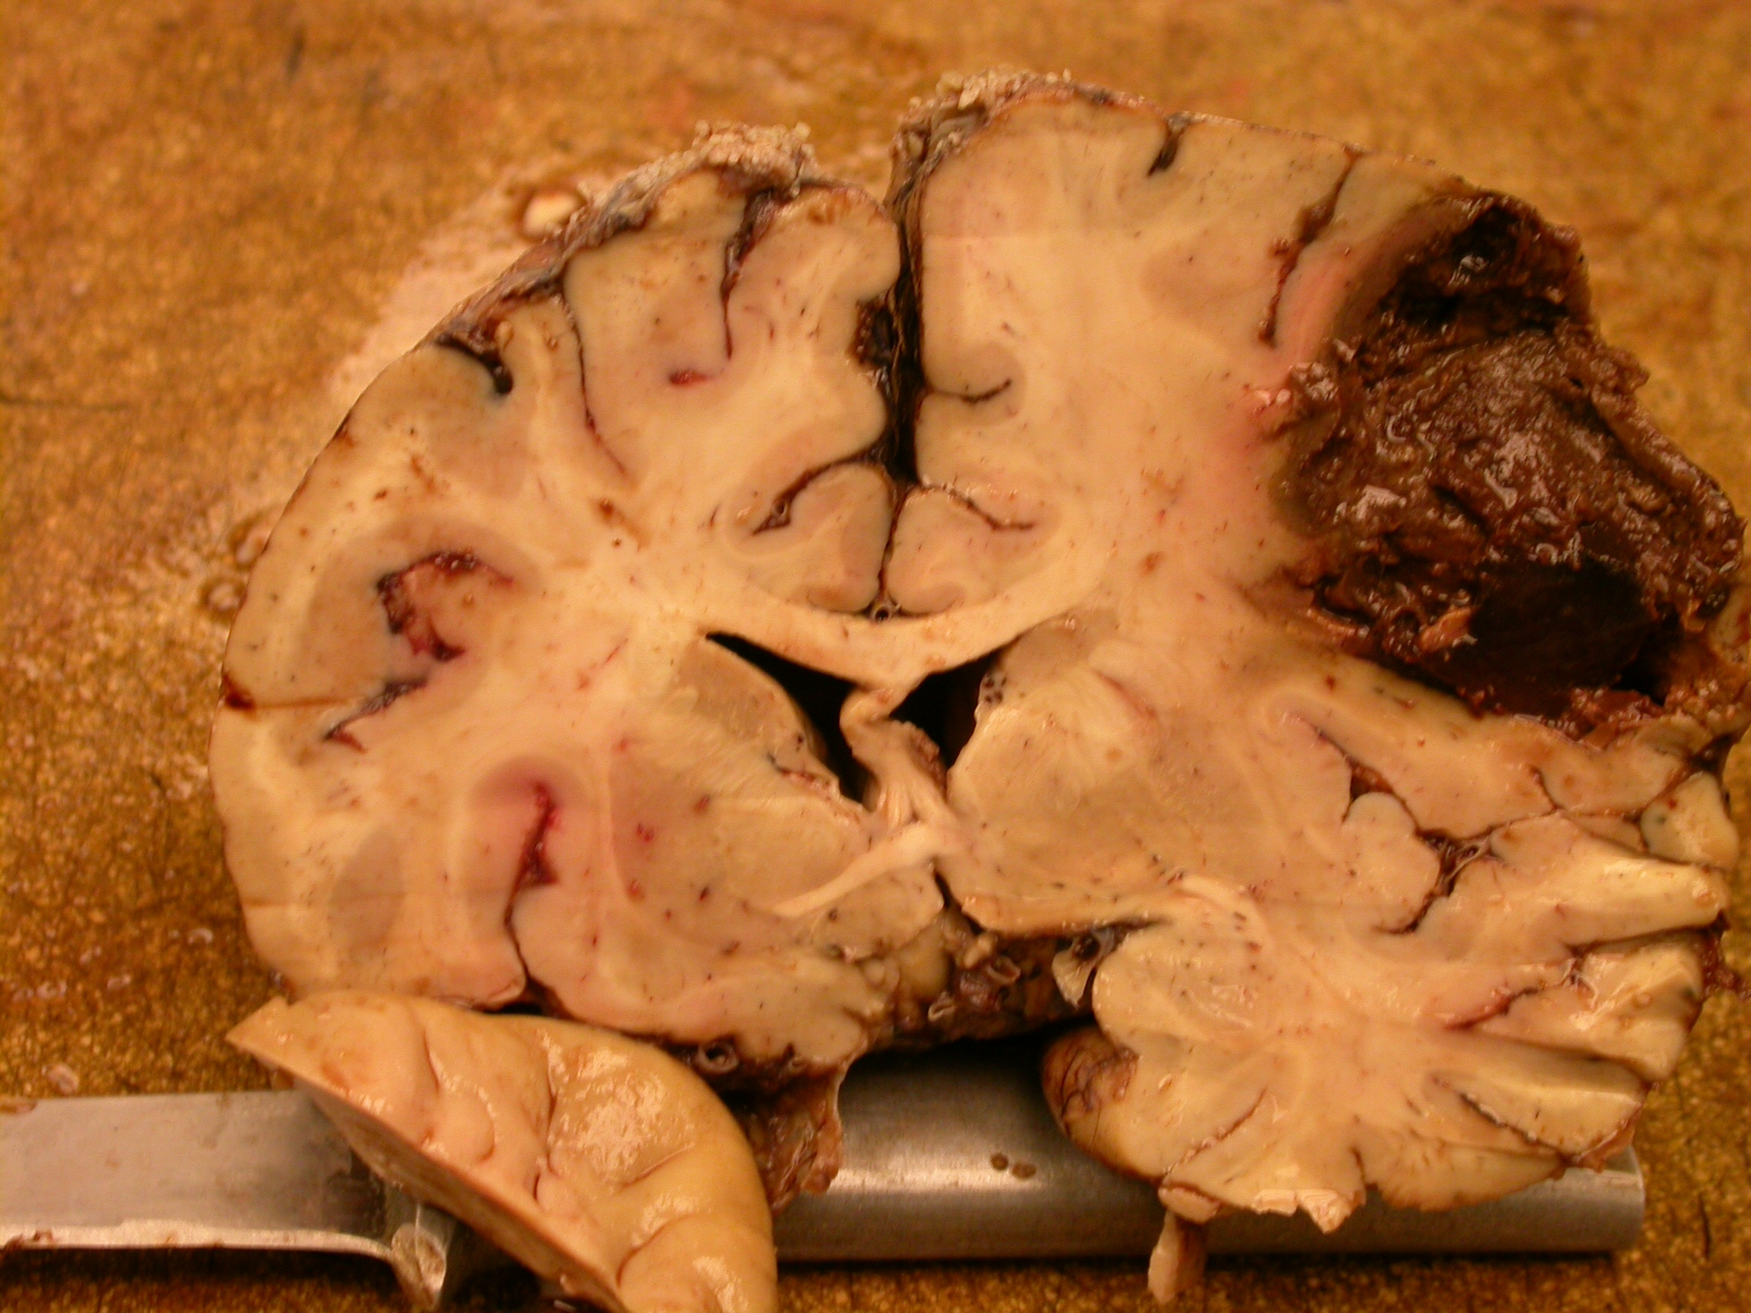
Brain Stroke
Hemorrhage
Brain Cross Section (Vertical)

Slide 3
Brain Stroke
Images: Brain stroke:
Stroke shown on a vertical cross section of a brain:
http://www-medlib.med.utah.edu/WebPath/CNSHTML/CNS223.html
Information on brain strokes:
Medline Plus Medical Encyclopedia:
http://www.nlm.nih.gov/medlineplus/ency/article/000761.htm
National Institute of Neurological Disorders and Stroke:
http://www.ninds.nih.gov/disorders/stroke/stroke.htm

