Slide 1
Normal Lungs
Images: Lung:
Lung cross section:
http://www.meddean.luc.edu/lumen/bbs/p/ppi2.html
Normal lungs and heart:
http://www.meddean.luc.edu/lumen/bbs/p/ppi1.html
Information on lung anatomy and physiology:
Gray’s Anatomy – Lungs:
http://www.bartleby.com/107/240.html
The Candian Lung Association:
http://www.lung.ca/lung101-renseignez/respiratory-respiratoire/how-comment/index_e.php

Slide 2
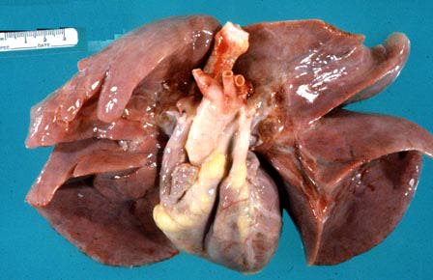
Normal lungs and heart. The pleural surface is smooth and shiny. The lungs extend down to the apex of the heart.

Slide 3
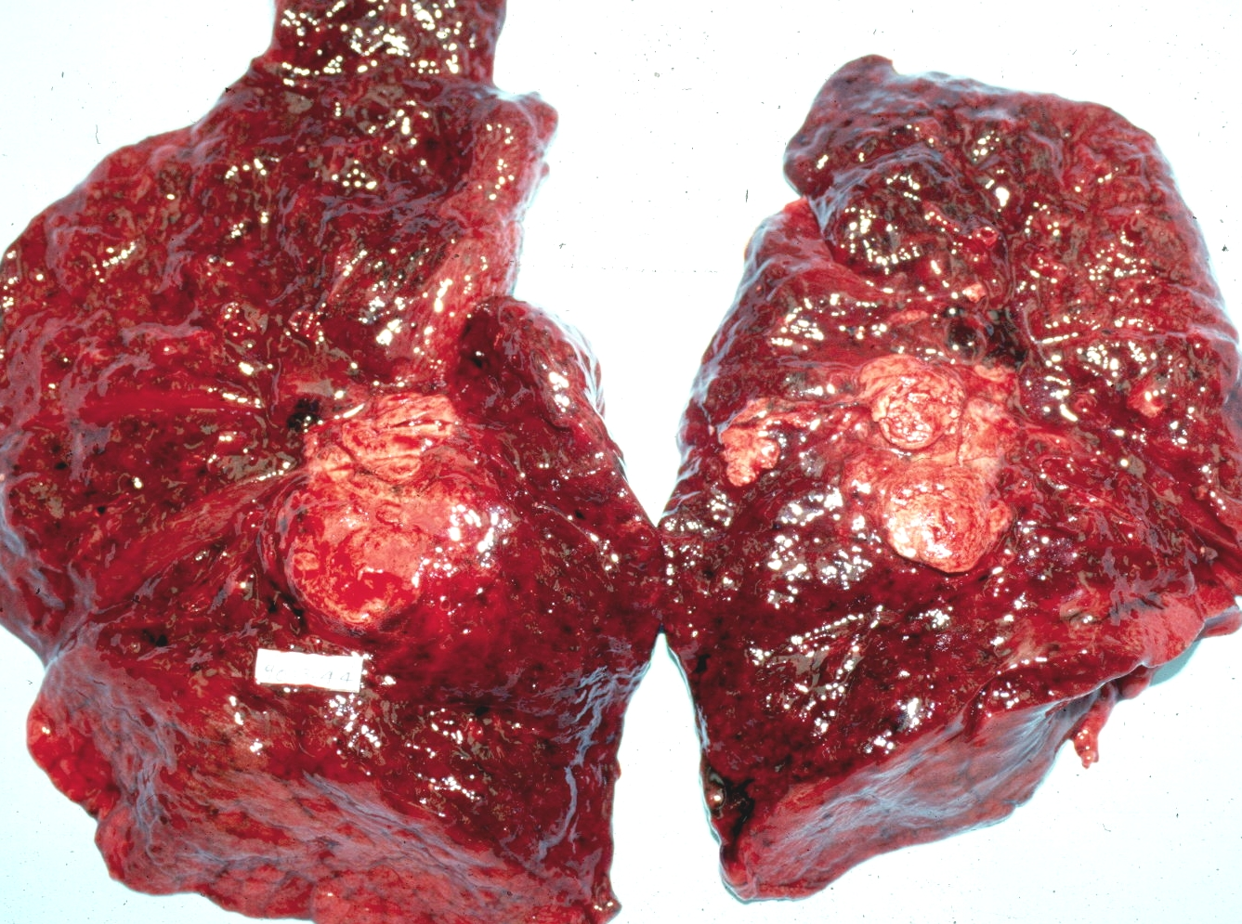
Cancerous Lung

Slide 4
Lung Cancer
Images: Lung cancer:
Gross cross section:
http://www-medlib.med.utah.edu/WebPath/LUNGHTML/LUNG068.html
Multiple masses:
http://www-medlib.med.utah.edu/WebPath/LUNGHTML/LUNG078.html
Quit Smoking Support (multiple types of diseased lungs pictured):
http://www.quitsmokingsupport.com/lungphotos.htm
Information on lung cancer:
Medline Plus Medical Encyclopedia:
http://www.nlm.nih.gov/medlineplus/ency/article/000122.htm
Lung Cancer.org:
http://www.lungcancer.org/reading/

