Slide 1
Stab Wounds
Look at the following images.
Make observations about the shape of the wound.
Make an assumption about the instrument used.
Notes:
6 images

Slide 2
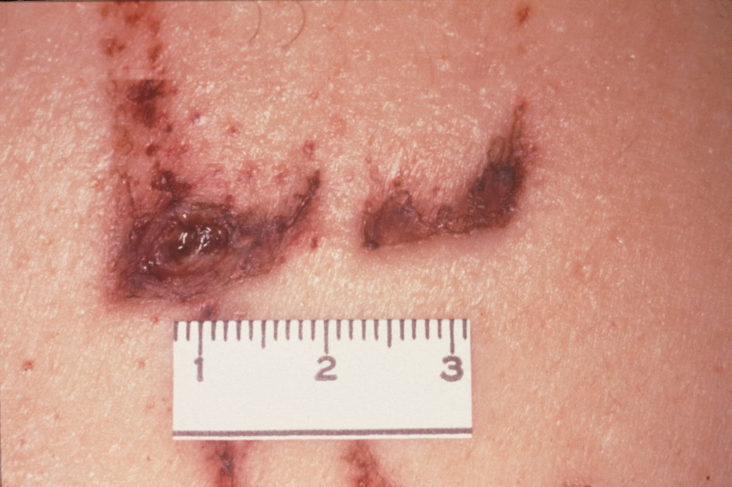

Slide 3
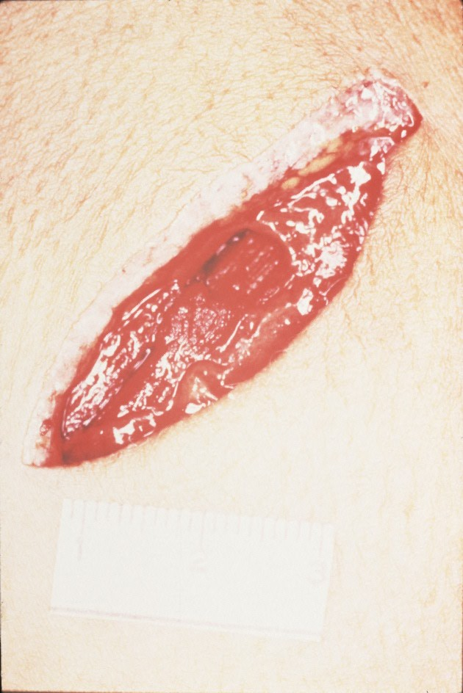

Slide 4
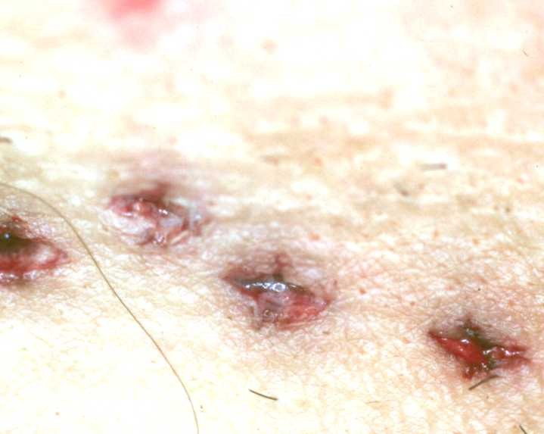

Slide 5
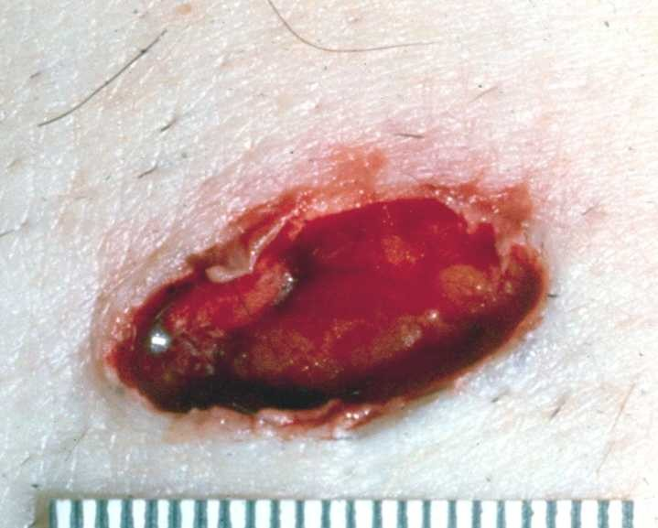

Slide 6
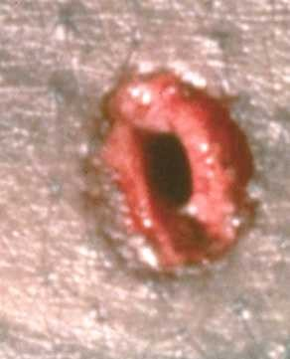

Slide 7
